Slide 1
LDOE English Learner Program Updates
November 1, 2019
Alice Garcia

Slide 2
Today’s Agenda
Guiding Beliefs
Policy and Guidance Updates
State ELs at a Glance
EL Community of Practice: Overview
Wrap-up

Slide 3
Guiding Beliefs
Louisiana’s students—all of them, no matter race, disability, or creed—are as smart and capable as any in America. They have gifts and talents no lesser than those given to any children on this earth.
Louisiana has worked hard to raise expectations for students, and as a result, students are performing at higher levels than ever before.
While Louisiana has made great strides in increasing life opportunities for its students, there remain serious challenges in Louisiana’s schools. Often these challenges are experienced to the greatest extent by children of historically disadvantaged backgrounds.
As educators, we have a powerful role to play in helping all students overcome the challenges they will experience on the way to leading healthy and productive lives as adults.

Slide 5
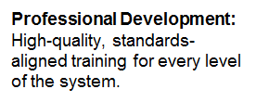
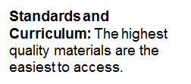
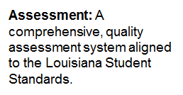
Theory of Change

Slide 7
Policy and Guidance Updates

Slide 8
EL Policy Updates: Bulletin 111
Bulletin 111:
C. Accommodations for the English Language Proficiency Test (ELPT) must be documented on a student’s Individual Education Plan (IEP), or Individual Academic Plan (IAP) no later than 30 days prior to the opening of the testing window.
D. Students with disabilities who are unable to meet the above exit criteria after four years or more in EL status, and whose disability impacts language acquisition, may be reclassified and exempt from future ELPT participation, but will be required to take statewide assessments. In such cases, the IEP team determines that the student’s disability directly impacts language acquisition; then, the student’s reclassification and exit is decided by consensus of the members of the School Building Level Committee (SBLC). Students with significant cognitive disabilities who meet the participation criteria for LEAP Connect may be reclassified and exited sooner until such time as an alternate ELPT is available.

Slide 9
EL Policy Updates: Bulletin 741
Bulletin 741: (These are the highlights)
D. LEAs must identify within thirty (30) days of school enrollment students in need of specialized language assistance programs. The state approved standardized entrance and exit must be followed, as referenced in LAC 28:CXI.
G. In addition to offering equal access to the core curriculum, LEAs must provide ELs with equal opportunities to participate meaningfully in all programs and activities, whether curricular, co-curricular, or extracurricular.
I. LEAs have the obligation to communicate meaningfully with parents who have limited English proficiency skills and to adequately notify them of information about any program, service, or activity called to the attention of non EL parents. LEAs must have a process to identify parents with limited English skills and provide them with free and effective language assistance, such as translated materials or an appropriate and trained interpreter.

Slide 10
EL Policy Updates: Bulletin 118
Bulletin 118:
A. English Learners (EL) are to be identified through a two-step standardized process:
1. Upon enrollment in school, parents or custodians are provided with a Home Language Survey (HLS) designed to identify which students are potential English Learners and therefore require an assessment of their English language proficiency.
2. If an assessment is required, LEAs must administer the English Language Proficiency Screener (ELPS), which assesses proficiency in all four language domains – speaking, listening, reading, and writing – within 30 days

Slide 11
Guidance on Spanish Math Assessments
LEAP 2025 mathematics assessments are available in Spanish for grades 3-8, Algebra I and Geometry, however, schools should use the follow guidance when deciding which students will take the assessments in Spanish.

Slide 12
Guidance on Grading English Learners
The USDOE provides the following guidance on grading ELs:
When grading English Language Learners, consideration should be given to research that suggests retention of students based on language proficiency and academic background can have negative effects on students
This means, that an EL should not fail a class because they are unable to access the content due to a lack of English proficiency.
Beyond this, grading is a district policy. I recommend that the student be graded based on putting forth adequate effort.
If the class is a modified (for ELs only) class, they can fail.
If the EL is receiving all of their accommodations/modifications and is not able to access the class, please re-evaluate the checklist.
If the student is not coming to class or is refusing to do anything, document and the student call fail.

Slide 13
Guidance on Identifying ELs as SWD
ELs can and should be referred for SPED services if there is the possibility of an exceptionality.
It is vital to make the distinction between language proficiency and a possible learning disability—they are not one and the same.
Factors to consider when referring for evaluation:
Can the student perform as expected in their own language?
Is the student not making adequate progress in language development (4-7 years)?
Does the student struggle with mathematics when there are no word problems?

Slide 14
EL State Profile

Slide 15
Key Challenges Specific to English Learners
English Learners are not homogenous. They come from diverse backgrounds and cultures, speak different languages and have diverse educational experiences and expectations.
English Learners enter our school system at varying levels of English language proficiency.
Some English Learners enter our school system with needs beyond language acquisition, including trauma in some cases.
Many teachers often feel unprepared and often assume that they cannot teach content to English Learners if they do not speak the same language.
Some EL teachers/instructional specialists lack content knowledge and provide language support services that are disconnected from or in isolation from core content.
It’s difficult to engage the families because many feel there might be too much unwanted scrutiny.

Slide 16
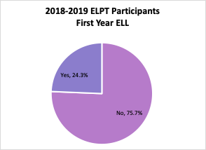
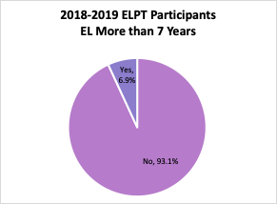
State-Wide Demographics:
Number of Years Served
The majority (76%) of ELs are NOT newcomers, nor are they Long-Term ELs (93%)

Slide 17
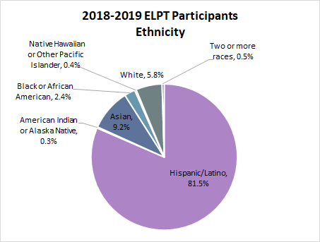
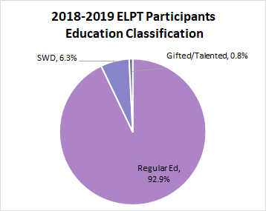
State-Wide Demographics:
Ethnicity and Education Classification
81% of ELs are Hispanic/Latino and 93% are classified as regular education.

Slide 18
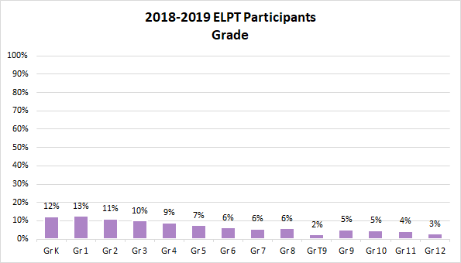
State-Wide Demographics:
ELPT Participants by Grade
Close to 50% of ELs are in grades K-3

Slide 19
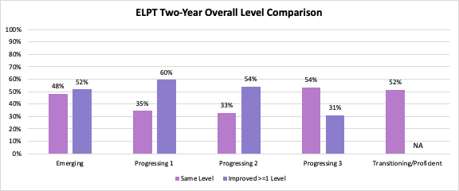
Language Proficiency:
State-Wide EL Growth As Measured By ELPT
In general, ELs are showing growth in language proficiency, but not at all levels and not quickly enough.

Slide 20
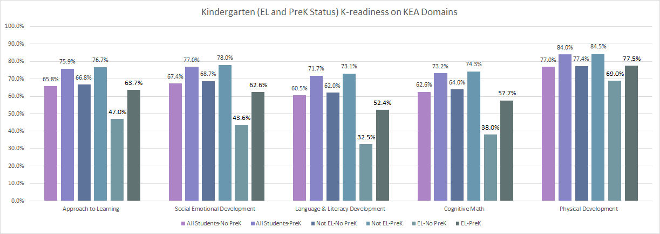
What Do We Know About English Learners and PreK?
English Learners (EL) attending PreK consistently performed better on all 5 KEA domains than those who did not attend PreK.

Slide 21
Community of Practice Initiative

Slide 22
EL Community of Practice: Focus Areas
Focus Area 1: | Using screening and assessment data to build a district EL profile
Focus Area 2: | Planning for high quality instruction and supports
Focus Area 3: | Engaging families effectively
Focus Area 4: | Monitoring and evaluating the effectiveness of EL programming
LDOE has started a series of professional development sessions called the EL Community of Practice. EL supervisors from across the state will come together throughout the school year to develop a deeper understanding of the four focus areas. Meetings began in October.

Slide 23
Focus Area 1
Using screening and assessment data to build a district EL profile
ELPS/ELPT is administered as instructed and student reports produced.
2. Analyze reports for program placement (ELPS), language support services (ELPS/ELPT), to fill-out the EL Accommodation Checklist (ELPS/ELPT) and, if your school is using, an EL Instructional Support Plan. All of these are revised each year to meet the student’s individual needs.
3. Use these same reports to compile school system EL profile to make EL program decisions.

Slide 24
Focus Area 2
Planning for high quality instruction and supports
Consider the needs of your ELs, your available staff and/or faculty, and building space.
Not all ELs should be supported in the same way.
Are you getting a lot of SIFEs? Pursue program options and present them with graduation alternatives
Newcomer ELs have different needs than those who have been here a year or more.
Meeting the needs of ELs in K-3 is quite different than ELs in grades 6-12.

Slide 25
EL Program Models
EL Coach-specifically trained EL specialist works with content teachers to identify individualized targeted language supports while ELs remain in their content classrooms
Two-Way Immersion-integrates native English speakers and native Spanish speakers with the goals of promoting high academic achievement, first and second language development and cross-cultural understanding for all students
Content Based English Instruction-utilizes subject matter concepts as the context for language learning, allowing development of English proficiency in the four language domains (listening, speaking, reading and writing) in a purposeful and meaningful manner.

Slide 26
Focus Area 3
Engaging Families Effectively
Family engagement should start the moment they enroll. Find out how parents/guardians want information communicated to them.
Provide translators (not just students) at family events.
Provide any communication home in your most prevalent languages (Or provide them digitally so they can translate them)
Do robo-calls in another language.
Begin small, but be prepared to expand.

Slide 27
Focus Area 4
Monitoring and evaluating the effectiveness of EL programming
This goes beyond what we do at the state.
Once you’ve made a decision to try a new type of EL programming, monitor its effectiveness by reviewing data from attendance, assessments, and teacher input.
Make sure that the program was enacted with fidelity and that the data collected is accurate.
Update your school information systems regularly to reflect current EL enrollment.

Slide 28
Wrap-Up
More questions?
Funding and Compliance: melanie.mayeux@la.gov
EL Instructional Programs: alice.garcia@la.gov
Accountability: jennifer.baird@la.gov
EL Assessments: assessment@la.gov

Slide 29
Resources
EL Newcomer Toolkit
https://www2.ed.gov/about/offices/list/oela/newcomers-toolkit/ncomertoolkit.pdf
English Learners and Title III Non-Regulatory Guidance
https://www2.ed.gov/policy/elsec/leg/essa/essatitleiiiguidenglishlearners92016.pdf
English Learner Toolkit
https://www2.ed.gov/about/offices/list/oela/english-learner-toolkit/eltoolkit.pdf
Civil Rights Obligations
https://www2.ed.gov/about/offices/list/ocr/ellresources.html
English Learner Library
https://www.louisianabelieves.com/resources/library/english-learners

